Slide 1



PROJECT PROCUREMENT MANAGEMENT
LECTURE # 14

Slide 2

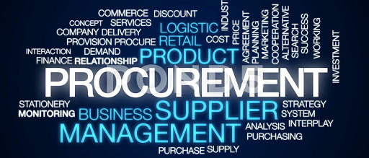
WHAT IS PROCUREMENT
Procurement is an act of acquiring works, goods and services from external suppliers.

Slide 3
Project Procurement Management
Project Procurement Management includes the processes required to acquire goods and services from outside the performing organization.
Overview of the following major processes:
  Procurement Planning – determining what to procure and when.
  Solicitation Planning – documenting product requirements and identifying potential sources.
  Solicitation – obtaining quotations, bids, offers, or proposals as appropriate.
  Source Selection – choosing from among potential sellers.
  Contract Administration – managing the relationship with the seller.
  Contract Close-out – completion and settlement of the contract, including resolution of any open items.

Slide 4
Buyer-Seller Relationship
Project Procurement Management is discussed from the perspective of the buyer in the buyer-seller relationship.
The buyer becomes the customer and is thus a key stakeholder for the seller.
The company or person who provides services and goods can be called a contractor, subcontractor, supplier, designer, or vendor. 'The PMBOK" Guide primarily uses the term "seller."
.
The terms and conditions of the contract become a key input to many of the seller’s processes. The contract may actually contain the input (e.g., major deliverables, key milestones, cost objectives) or it may limit the project team’s options (e.g., buyer approval of staffing decisions is often required on design projects).

Slide 5
Centralized vs. Decentralized Procurement
Centralized Procurement:
  In centralized purchasing buying and managing process is performed from one location to all locations within an organization. This can also be run by a central location buying into a distribution warehouse that feeds smaller warehouses. This is called a hub-and-spoke system.
Decentralized Procurement:
  In large firms there are many branches, sections or departments. If each branch or department buys its own materials and equipment, it is known as decentralized purchasing.

Slide 6
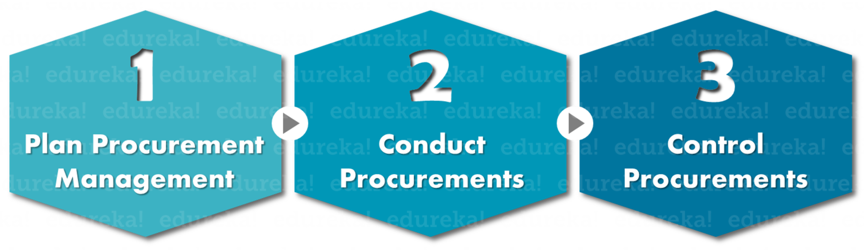
PROCUREMENT MANAGEMENT PROCESS

Slide 7
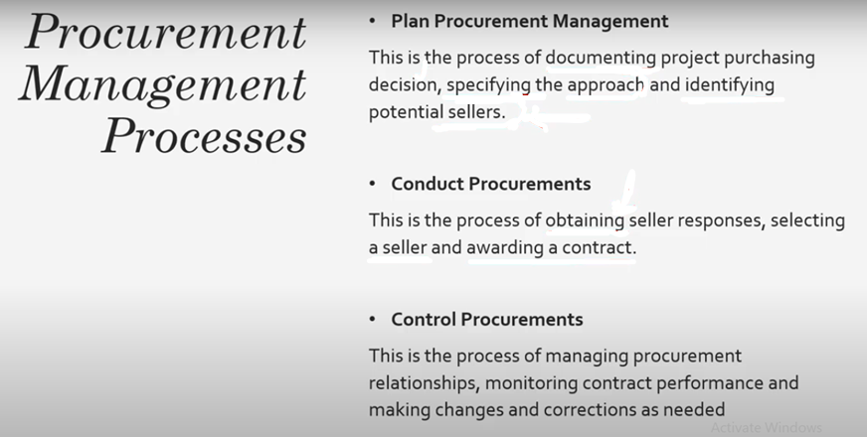
PROCUREMENT MANAGEMENT PROCESS

Slide 8
Plan Procurement Management
Plan procurement management is the initial process of project procurement management knowledge area.
It helps in identifying which resources are to be acquired and when.
In this process, you need to document various procurement decisions, specify the procurement approach and identify the potential and quality sellers.
It also helps in identifying potential suppliers.
Basic Questions: "How will make-or-buy analysis be performed ?" "What goods or services do we need to buy for this project? "How will we purchase them? "Who are potential sellers? “
This process involves putting together the bid documents that will be sent to prospective sellers describing the buyer's need, how to respond, and the criteria the buyer will use to select a seller.

Slide 9
Activities in Plan Procurement Management
Performing make-or-buy analysis- Time; cost; Expertise; resources
Creating a procurement management plan –Approach that will be used; policies and procedures; outlines the roles and responsibilities of team members; Templates; how to conduct M&C?
Creating a procurement strategy for each procurement –Three basic elements: how goods or services will be delivered to the buyer, what type of contract will be used & how the procurement will be carried out throughout each phase.
Creating a procurement statement of work for each procurement- What work is required must be defined clearly.
Creating the appropriate contract type for each procurement
Creating the bid documents
Determining the source selection criteria –Technical Requirements, Quality; Price; Reputation etc.

Slide 10
CONDUCT PROCUREMENT
In this process responses from various sellers are collected, an efficient seller is selected among them and finally, a contract is curated.
This process involves bid documents including procurement statement of work and other documents to prospective sellers, answering the sellers' questions, and receiving and evaluating sellers' responses. You will select a seller using the source selection criteria specified in the procurement management and then negotiate a contract.

Slide 11
Activities in Conduct Procurement
A buyer may use techniques such as advertising to find possible sellers or may send the bid document to a select list of sellers pre-approved by the organization.
The buyer may invite the sellers to attend a meeting -called a bidder conference, contractor conference, vendor conference or pre-bid conference -in which they can tour the buyer's facilities or attend an online forum and ask questions about the procurement
A seller’s proposal is usually the response to bid documents. The seller’s proposal (or price quote or bid) represents an official offer from the seller

Slide 12
Activities in Conduct Procurement
Proposal Evaluation:
Buyer may simply select a seller and ask them to sign a standard contract.
Buyer may ask a seller to make a presentation, and then, if all goes well, move on to negotiations.
The buyer may narrow down (''short-list”) the list of sellers to a few.
The buyer may ask the short-listed sellers to make presentations, and then ask the selected ones to go on to negotiations.
The buyer may negotiate with more then one seller.
The buyer may use some combination of presentation and negotiations.

Slide 13
Activities in Conduct Procurement
Weightage-criteria
Number of years in business
Understanding of need Price or life
Technical ability
Ability to complete the work on time
Project management ability
Total score for this seller
Past Performance
Presentation
Negotiations

Slide 14
Control Procurement
It involves managing the relationship between the buyer and seller, and ensuring that both parties perform as required by the contract and that each contract is closed when completed or terminated.
Throughout this process, the seller is focused on completing the work while the buyer is focused on measuring the performance of the seller and comparing actual performance to the contract, other procurement documents and plans.

Slide 15
Activities in Control Procurement
Authorize payments to the seller.
Interpret what is and what is not in the contract.
Resolve disputes.
Evaluate whether a change is needed and is within the approved scope of the project.
Work with the procurement manager on requested and approved changes
Send copies of changes to the appropriate parties.
Hold procurement performance review meetings with your team and the seller.
Prepare Report on performance
Monitor schedule and technical performance against the contract
Control quality according to what is required m the contract.
Review claims submitted by the seller.
Document lessons learned, and make recommendations to the organization for improvement.
Accept final deliverables from the seller, and make final payments.

Slide 16
CONTRACT
CONTRACT may be defined as
“An Agreement enforceable by law ”.
These agreements creates Rights and Obligations between the Parties which can be claimed in the Court of Law.(Legal Obligation).
The PMI definition of a Contract is:
“A contract is a mutually binding agreement that obligates the seller to provide the specified product and obligates the buyer to pay for it”.

Slide 17
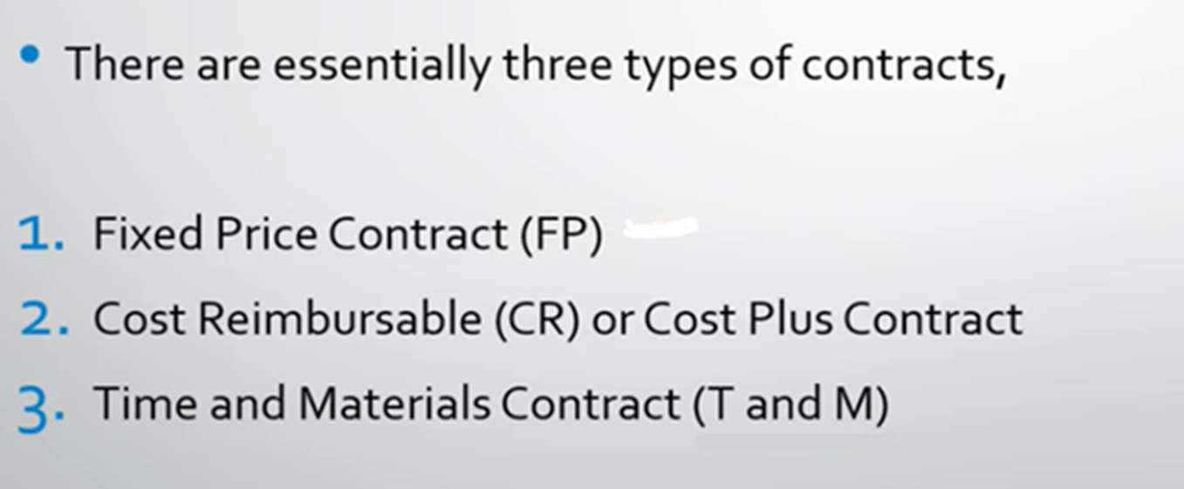
TYPES OF CONTRACT

Slide 18
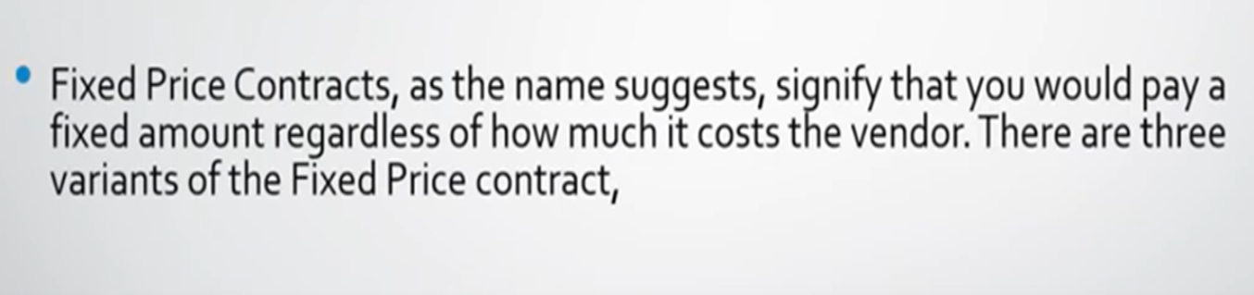
FIXED PRICE CONTRACT

Slide 19
TIME & MATERIAL CONTRACT
In this type of contract, the buyer pays on a per-hour or per-item basis. Time and material contracts are frequently used for service efforts in which the level of effort cannot be defined when contract is awarded.

Slide 20
COST REIMBURSEMENT
Cost reimbursement contract are used when the scope is not clear and cost cannot be accurately estimated.
This allows the buyer to pay the seller allowable incurred cost to the extend provided in contract.
This add additional fee or reward to the cost for the seller profit

Slide 21
Few Contractual Terms
Acceptance How will you specifically know if the work is acceptable?
Agent Who is an authorized representative of each party?
Arbitration It is method to resolve disputes uses private third parties to render a decision on the dispute. It is usually faster and cheaper than the courts.
Assignment This refers to the circumstances under which one party can assign its rights or obligations under the contract to another.
Authority Who has the power to do what?
Changes How will changes be made? What forms will be used? What are the timeframes for notice and turnaround ?
Confidentiality/ nondisclosure What information must not be made known or gh·en to third parties?
Dispute resolution How will any disputes regarding the contract be settled? Some options for dispute resolution are to use the courts or in arbitrator.
Force majeure 'This refers to a situation that could be considered an "act of nature;' such as a fire or storm, and it is an allowable excuse for either party not meeting contract requirements. If a force majeure occurs, it is considered to be neither party's fault. It is usually resolved by the seller receiving an extension of time on the project. Who pays for the cost of the items destroyed in a fire or other force majeure? Usually the risk of loss is borne by the seller and is hopefully covered by insurance

Slide 22
Incentives These are benefits the seller may receive for achieving the buyer's objectives of schedule, cost, quality, risk, and performance.
lndemnification (liability) Who is liable for personal injury, damage, or accidents?
Independent contractor This means the seller is not an employee of the buyer.
Inspection Does anyone have a right to inspect the work during the execution?
Site access This describes any requirements for access to the site where the work will be performed.
Time is of the essence Delivery dates are strictly binding. The seller is on notice that time is important and that any delay is a material breach.
Warranty Item which is critical to be specified in this term is the time period covered by a seller's warranty.

Slide 23

THANK YOU

